Slide 1
Multi-Agent Auditability
State-of-the-Art Tools & Standards
Enterprise & Open-Source Solutions for Production AI Systems
March 2026 • Agent Observability Guide

Slide 2
State-of-the-Art Enterprise Auditability Tools
Tool | Type | Core Strengths | Best For | Pricing
Vorlon AI Flight Recorder | Enterprise | Patented DataMatrix, immutable audit trails, blast radius <60s | Financial services, healthcare compliance | Custom enterprise
LangSmith | Commercial | LangGraph native, full trace replay, automatic instrumentation | LangChain workflows, multi-agent coordination | $39/user/month
Datadog LLM Obs | Enterprise | APM integration, enterprise-grade security, cross-platform | Existing Datadog users, hybrid cloud | $15/host/month
AWS Bedrock AgentCore | Cloud Native | OpenTelemetry native, CloudWatch integration, memory tracking | AWS ecosystem, serverless agents | Pay-per-trace
Azure AI Foundry | Cloud Native | Unified dashboard, AI-assisted RCA, 90-day retention | Azure users, compliance-heavy industries | Per GB ingested
Arize AI | Specialized | Prompt evaluation, hallucination detection, toxicity scoring | LLM quality monitoring, production debugging | $500/month+

Slide 3
Open-Source & Cost-Effective Solutions
Tool | License | Core Strengths | Best For | Deployment
Langfuse | MIT (Open) | Self-hostable, framework-agnostic, full control, PostgreSQL backend | Data sovereignty, cost optimization, on-prem requirements | Docker, K8s, Cloud
Phoenix (Arize) | Apache 2.0 | Embeddings visualization, drift detection, local inference tracing | LLM quality analysis, experimentation, RAG debugging | pip install, Docker
OpenLIT | Apache 2.0 | GPU metrics, cost tracking, OTel-native, PromQL queries | Cost optimization, resource monitoring, multi-cloud | Docker, K8s
LangWatch | MIT (Open) | Regression detection, quality scoring, evaluation automation | Continuous monitoring, A/B testing, quality gates | Docker, Cloud
OpenTelemetry + Jaeger | Apache 2.0 | Industry standard, vendor-neutral, distributed tracing, massive scale | Custom instrumentation, multi-framework, polyglot stacks | Self-hosted

Slide 4
OpenTelemetry Standards for Agent Auditability
Trace Context Propagation
W3C Trace Context headers ensure end-to-end visibility across agent boundaries, microservices, and cloud platforms
Semantic Conventions
Standardized attributes (gen_ai.*, llm.*) for LLM calls, prompts, tokens, model versions, ensuring vendor-neutral observability
Auto-Instrumentation
Zero-code SDKs for Python, Node.js, Java capture agent interactions automatically without manual tracing code
Reinforcement Best Practices
Use OTel Collector for centralized telemetry routing and filtering
Implement sampling strategies (tail-based) to capture errors while controlling costs
Add custom spans for agent decision points, tool invocations, memory operations
Enforce baggage propagation for user context, session IDs, compliance metadata

Slide 5
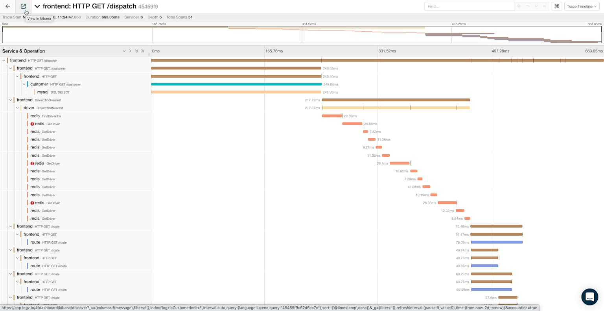
Agent Auditability Failure: Anatomy of Breakdown
❌ Missing Decision Provenance
Agent approved 247 claims but no record of which policy rules were evaluated or why they passed
❌ Data Lineage Gap
Cannot determine which PDF policy docs were accessed, which embeddings retrieved, or RAG retrieval scores
❌ Cross-Agent Coordination Black Hole
Multi-agent handoffs invisible—which agent made final decision? When? Based on what data?
❌ Blast Radius Unknown
Incident discovered 19 days later—impossible to identify all affected claims sharing the same pattern
Audit Reconstruction Time: 19 Days
Without proper instrumentation, auditors manually reconstruct agent behavior from fragmented logs, losing causal relationships and decision context

Slide 6
Thank You!
Questions?
Build auditability into agent architecture from day one. OpenTelemetry standards + right tooling = production confidence.

